Slide 1

Method of Moments based on a surface admittance operator (MoM-SO):
An Introduction
Adilton Junio Ladeira Pereira
adt@ufmg.br
Programa de Pós-Graduação em Engenharia Elétrica (PPGEE-UFMG)
Belo Horizonte, julho de 2024

Slide 2

Agenda
Introduction
    Motivation
    Differential Surface Admittance Concept
Circular Conductors Surrounded by a Homogeneous Lossless Medium
    Problem Statement
    Surface Admittance Operator
    Electric Field Integral Equation (EFIE)
    Analytic Evaluation of Discrete Green’s Function
p.u.l. Impedance
    Partial p.u.l. Impedance
    Total p.u.l. Impedance
Case Studies
    Bifilar Line
    Coaxial (single core) Cable

Slide 3
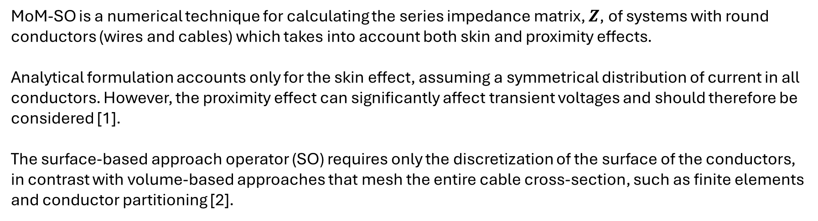
Introduction
Motivation
MoM-SO is a numerical technique for calculating the series impedance matrix, $Z$, of systems with round conductors (wires and cables) which takes into account both skin and proximity effects.
Analytical formulation accounts only for the skin effect, assuming a symmetrical distribution of current in all conductors. However, the proximity effect can significantly affect transient voltages and should therefore be considered [1].
The surface-based approach operator (SO) requires only the discretization of the surface of the conductors, in contrast with volume-based approaches that mesh the entire cable cross-section, such as finite elements and conductor partitioning [2].

Slide 4


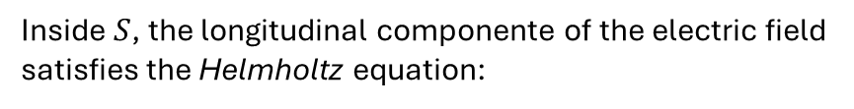



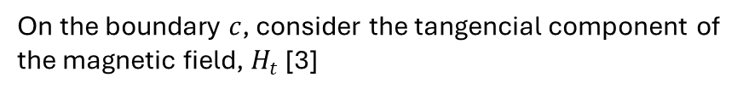

Introduction
Differential Surface Admittance Concept
On the boundary $c$, consider the tangencial component of the magnetic field, $H_{t}$ [3]
$$ε_{0},μ_{0}, σ_{0}$$
$$H_{t}=\frac{1}{jωμ_{0}}∂_{n}E_{z}$$
$$c$$
$$ε_{ },μ_{ }, σ_{ }$$
$$S$$
Inside $S$, the longitudinal componente of the electric field satisfies the Helmholtz equation:
$$a_{n}$$
$$∇^{2}E_{z}+k^{2}E_{z}=0$$
Original Problem
with
$$k=\sqrt{ωμ_{ }(ωε−jσ)}$$

Slide 5

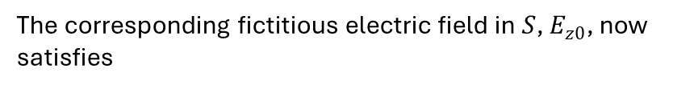




Introduction
Differential Surface Admittance Concept
Applying the Equivalence Principle [4], suppose that the constitutive parameters of the conducting cylinder are replaced by those of the medium outside the conductor.
$$ε_{0},μ_{0}, σ_{0}$$
$$c$$
$$ε_{0},μ_{0}, σ_{0}$$
The corresponding fictitious electric field in $S$, $E_{z0}$, now satisfies
$$S$$
$$∇^{2}E_{z0}+k_{0}^{2}E_{z0}=0$$
$$a_{n}$$
with
$$k_{0}=\sqrt{ωμ_{0}(ωε_{0}−jσ_{0})}$$
Equivalent Problem
$$H_{t0}=\frac{1}{jωμ_{0}}∂_{n}E_{z0}$$

Slide 6


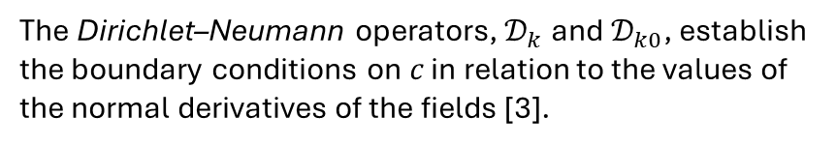






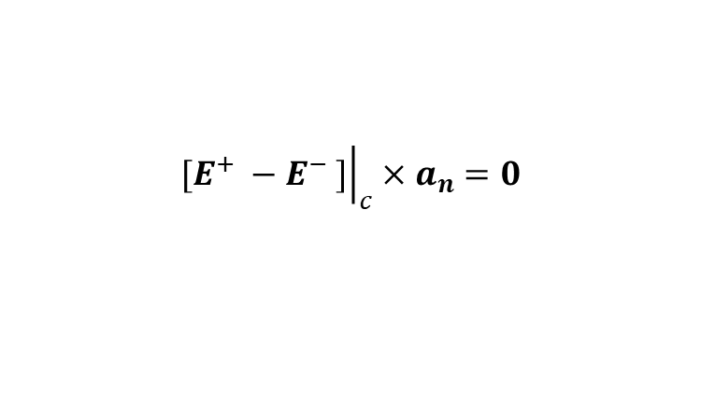
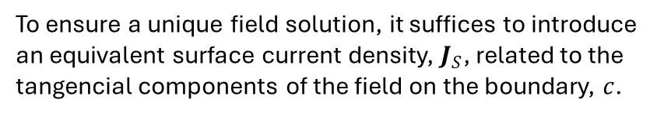

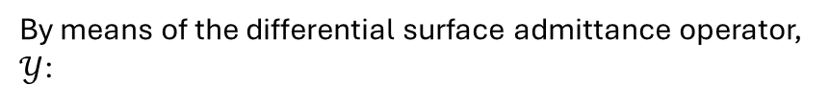
Introduction
Differential Surface Admittance Concept
To ensure a unique field solution, it suffices to introduce an equivalent surface current density, $J_{S}$, related to the tangencial components of the field on the boundary, $c$.
$$ε_{0},μ_{0}, σ_{0}$$
$$J_{s}=H_{t} −H_{t0}=\frac{1}{jωμ_{0}}[∂_{n}E_{z}−∂_{n}E_{z0}]$$
$$c$$
$$J_{s}$$
$$ε_{0},μ_{0}, σ_{0}$$
By means of the differential surface admittance operator, $𝒴$:
$$S$$
$$J_{s}= 𝒴 E_{z0}$$
$$a_{n}$$
$$𝒴=\frac{1}{jωμ_{0}}[𝒟_{k}−𝒟_{k0}]$$
Equivalent Problem
$${\left.a_{n}×{\left.[H^{+} −H^{−} ]\right|}_{c}=J_{s}\right|}_{c}$$
The Dirichlet–Neumann operators, $𝒟_{k}$and $𝒟_{k0}$, establish the boundary conditions on $c$ in relation to the values of the normal derivatives of the fields [3].
$${\left.[E^{+} −E^{−} ]\right|}_{c}×a_{n}=0$$

Slide 7

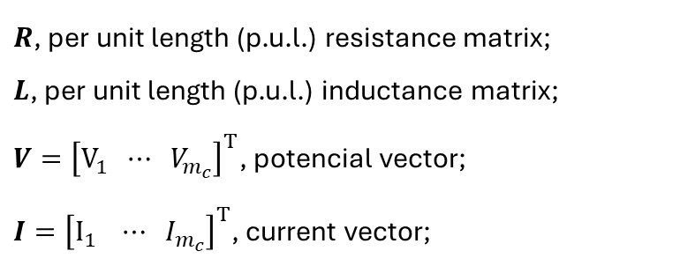



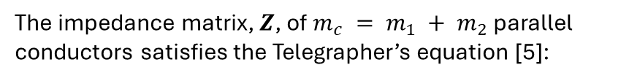


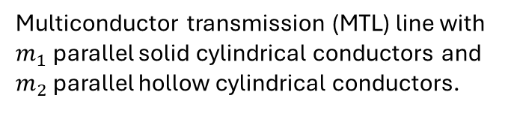

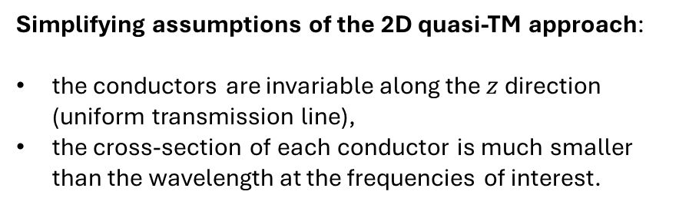
Circular Conductors Surrounded by a Homogeneous Lossless Medium
Problem Statement
$$ε_{0},μ_{0}$$
The impedance matrix, $Z$, of $m_{c} = m_{1} + m_{2}$ parallel conductors satisfies the Telegrapher’s equation [5]:
$$b_{q}$$
$$a_{p}$$
$$a_{q}$$
$$\frac{∂V}{∂z}=−\left[R\left(ω\right)+jωL\left(ω\right)\right]I$$
$$ε_{p},μ_{p}, σ_{p}$$
$$ε_{q},μ_{q}, σ_{q}$$
$R$, per unit length (p.u.l.) resistance matrix;
$L$, per unit length (p.u.l.) inductance matrix;
$V={\left[V_{1} ⋯ V_{m_{c}}\right]}^{T}$, potencial vector;
$I={\left[I_{1} ⋯ I_{m_{c}}\right]}^{T}$, current vector;
Multiconductor transmission (MTL) line with $m_{1}$ parallel solid cylindrical conductors and $m_{2}$ parallel hollow cylindrical conductors.
Simplifying assumptions of the 2D quasi-TM approach:
the conductors are invariable along the $z$ direction (uniform transmission line),
the cross-section of each conductor is much smaller than the wavelength at the frequencies of interest.

Slide 8
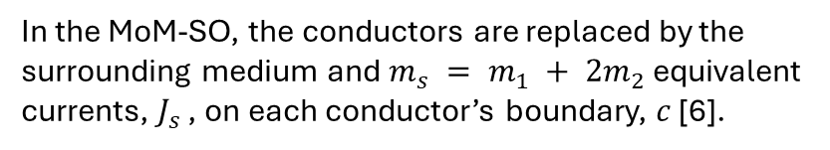

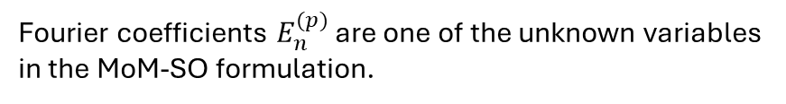

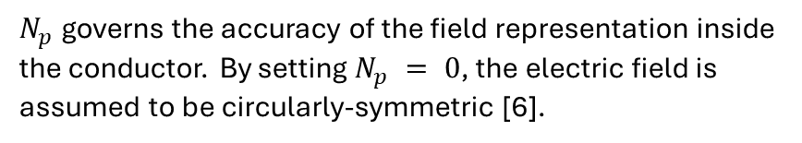




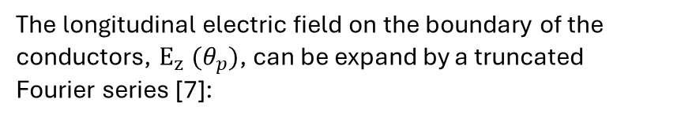




Circular Conductors Surrounded by a Homogeneous Lossless Medium
Surface Admittance Operator of the MTL
The longitudinal electric field on the boundary of the conductors, $E_{z}^{ } (θ_{p})$, can be expand by a truncated Fourier series [7]:
$$c_{p}$$
$$ε_{0},μ_{0}$$
$$c_{q}$$
$$E_{z}^{\left(p\right)}(θ_{p})=\sum_{n=−N_{p}}^{N_{p}}{E_{n}^{(p)}e^{jnθ_{p}}}$$
$$c_{r}$$
$$J_{s}^{(p)}$$
$$a_{p}$$
$$a_{r}$$
$$a_{q}$$
$$J_{s}^{(q)}$$
$$J_{s}^{(r)}$$
$N_{p}$ governs the accuracy of the field representation inside the conductor. By setting $N_{p} = 0$, the electric field is assumed to be circularly-symmetric [6].
Fourier coefficients $E_{n}^{(p)}$ are one of the unknown variables in the MoM-SO formulation.
In the MoM-SO, the conductors are replaced by the surrounding medium and $m_{s} = m_{1} + 2m_{2}$ equivalent currents, $J_{s}^{ }$ , on each conductor’s boundary, $c$ [6].

Slide 9

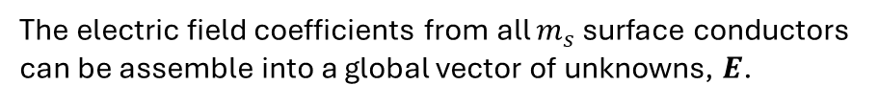
Circular Conductors Surrounded by a Homogeneous Lossless Medium
Surface Admittance Operator of the MTL
If $p$th-conductor is solid,
$$E^{(p)}={\left[E_{ −N_{p}}^{\left(p\right)}⋯E_{ 0}^{\left(p\right)}⋯E_{ N_{p}}^{\left(p\right)}\right]}^{T}$$
$$c_{p}$$
$$ε_{0},μ_{0}$$
$$c_{q}$$
$$c_{r}$$
otherwise, if $q$th-conductor is hollow then,
$$J_{s}^{(p)}$$
$$E^{(q)}={\left[E_{ −N_{r}}^{\left(r\right)}⋯E_{ 0}^{\left(r\right)}⋯E_{ N_{r}}^{\left(r\right)} E_{ −N_{q}}^{\left(q\right)}⋯E_{ 0}^{\left(q\right)}⋯E_{ N_{q}}^{\left(q\right)}\right]}^{T}$$
$$a_{p}$$
$$a_{r}$$
$$a_{q}$$
$$J_{s}^{(q)}$$
$$J_{s}^{(r)}$$
The electric field coefficients from all $m_{s}$ surface conductors can be assemble into a global vector of unknowns, $E$.
$$E={\left[E_{ }^{\left(1\right)} E_{ }^{(2)} ⋯E_{ }^{(m_{s})}\right]}^{T}$$
The size of $E$ is $N×1$, where
$$N=\sum_{p=1}^{m_{s}}{\left(2N_{p}+1\right)}$$

Slide 10
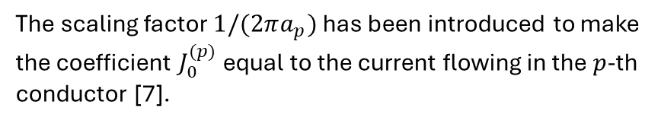

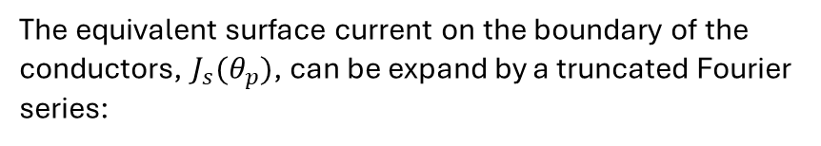
Circular Conductors Surrounded by a Homogeneous Lossless Medium
Surface Admittance Operator of the MTL
The equivalent surface current on the boundary of the conductors, $J_{s}^{ }(θ_{p})$, can be expand by a truncated Fourier series:
$$c_{p}$$
$$ε_{0},μ_{0}$$
$$c_{q}$$
$$J_{s}^{\left(p\right)}(θ_{p})=\frac{1}{2πa_{p}}\sum_{n=−N_{p}}^{N_{p}}{J_{n}^{(p)}e^{jnθ_{p}}}$$
$$c_{r}$$
$$J_{s}^{(p)}$$
$$a_{p}$$
$$a_{r}$$
$$a_{q}$$
$$J_{s}^{(q)}$$
$$J_{s}^{(r)}$$
The scaling factor $1/(2πa_{p})$ has been introduced to make the coefficient $J_{0}^{(p)}$ equal to the current flowing in the $p$-th conductor [7].
In a similar manner, we collect all the Fourier coefficients of the equivalent currents into a global vector
$$J={\left[J_{ }^{\left(1\right)} J_{ }^{(2)} ⋯J_{ }^{(m_{s})}\right]}^{T}$$

Slide 11
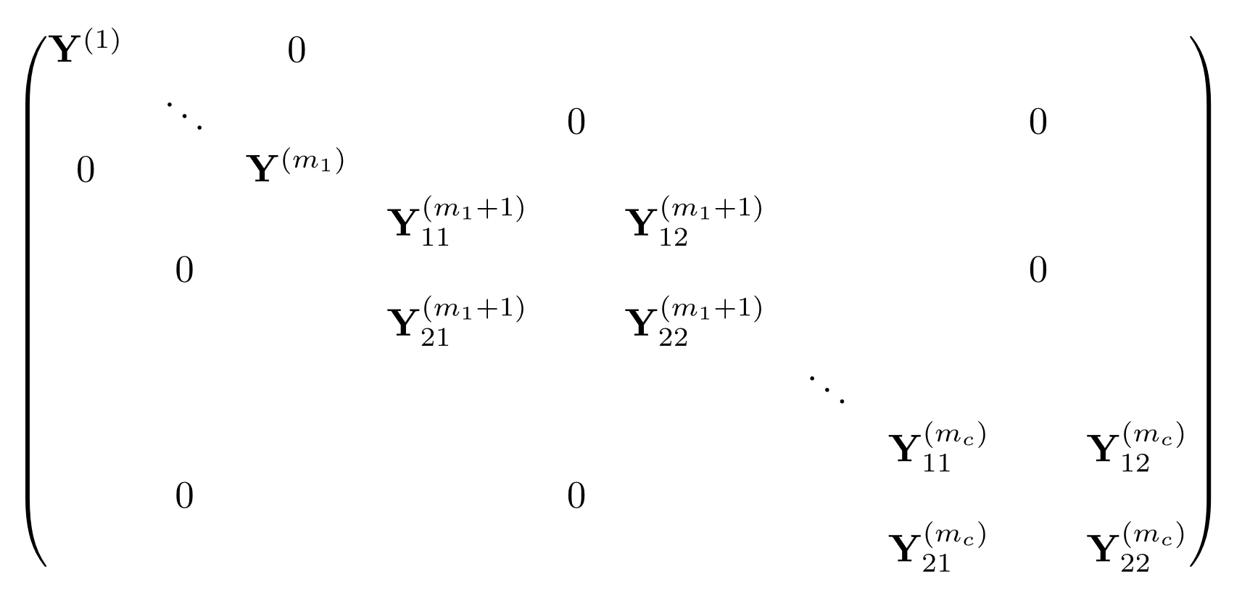


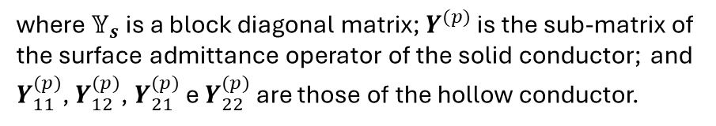



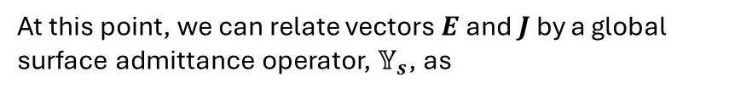
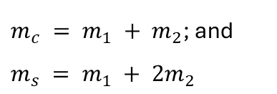
Circular Conductors Surrounded by a Homogeneous Lossless Medium
Surface Admittance Operator of the MTL
At this point, we can relate vectors $E$ and $J$ by a global surface admittance operator, $𝕐_{s}$, as
$$c_{p}$$
$$c_{q}$$
$$J=𝕐_{s} E$$
$$ε_{0},μ_{0}$$
$$𝕐_{s}=$$
$$c_{r}$$
$$J_{s}^{(p)}$$
$$a_{p}$$
$$a_{r}$$
$$a_{q}$$
$$J_{s}^{(q)}$$
$$J_{s}^{(r)}$$
$m_{1}$ solid conductors
$m_{2}$ hollow conductors
$$N×N$$
Recalling that,
where $𝕐_{s}$ is a block diagonal matrix; $Y^{(p)}$ is the sub-matrix of the surface admittance operator of the solid conductor; and $Y_{11}^{(p)}$, $Y_{12}^{(p)}$, $Y_{21}^{(p)}$ e $Y_{22}^{(p)}$ are those of the hollow conductor.
$m_{c} = m_{1} + m_{2}$; and $m_{s} = m_{1} + 2m_{2}$

Slide 12
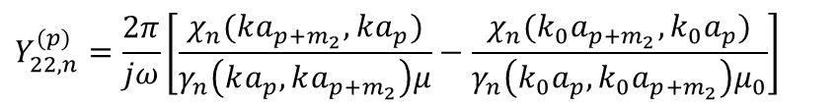
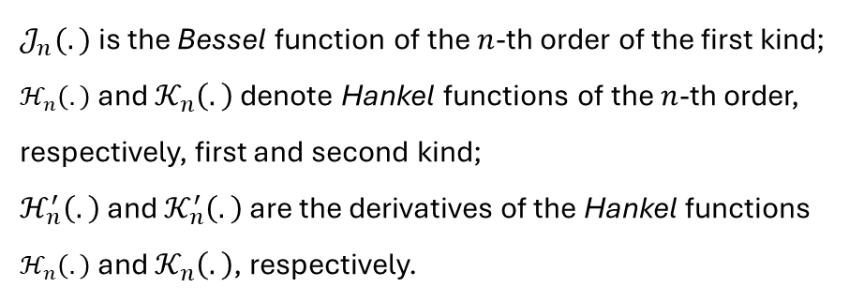
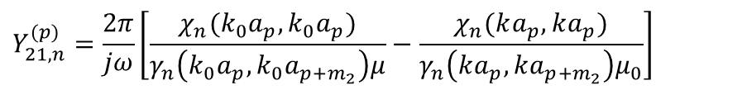
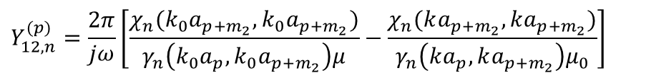
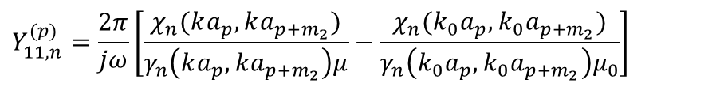
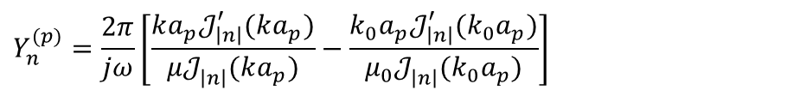
Circular Conductors Surrounded by a Homogeneous Lossless Medium
Surface Admittance Operator of the MTL
$Y^{(p)}$, $Y_{11}^{(p)}$, $Y_{12}^{(p)}$, $Y_{21}^{(p)}$ e $Y_{22}^{(p)}$ are diagonal matrices with entries:
$$Y_{n}^{(p)}={\frac{2π}{jω}\left[\frac{ka_{p}𝒥_{\left|n\right|}^{′}(ka_{p})}{μ𝒥_{\left|n\right|}^{ }(ka_{p})}−\frac{k_{0}a_{p}𝒥_{\left|n\right|}^{′}(k_{0}a_{p})}{μ_{0}𝒥_{\left|n\right|}^{ }(k_{0}a_{p})}\right]}^{ }$$
$$χ_{n}(α, β)={β\left[ℋ_{\left|n\right|}^{′}(β)𝒦_{\left|n\right|}^{ }(α)−ℋ_{\left|n\right|}^{ }(α)𝒦_{\left|n\right|}^{′}(β)\right]}^{ }$$
$$γ_{n}(α, β)={ℋ_{\left|n\right|}^{ }\left(α\right)𝒦_{\left|n\right|}^{ }\left(β\right)−ℋ_{\left|n\right|}^{ }(β)𝒦_{\left|n\right|}^{ }(α)}^{ }$$
$$Y_{11,n}^{(p)}={\frac{2π}{jω}\left[\frac{χ_{n}(ka_{p},ka_{p+m_{2}})}{γ_{n}\left(ka_{p},ka_{p+m_{2}}\right)μ}−\frac{χ_{n}(k_{0}a_{p},k_{0}a_{p+m_{2}})}{γ_{n}\left(k_{0}a_{p},k_{0}a_{p+m_{2}}\right)μ_{0}}\right]}^{ }$$
$k=\sqrt{ωμ(ωε−jσ)}$, $k_{0}=ω\sqrt{μ_{0}ε_{0}}$
$$Y_{12,n}^{(p)}={\frac{2π}{jω}\left[\frac{χ_{n}(k_{0}a_{p+m_{2}},k_{0}a_{p+m_{2}})}{γ_{n}\left(k_{0}a_{p},k_{0}a_{p+m_{2}}\right)μ}−\frac{χ_{n}(ka_{p+m_{2}}, ka_{p+m_{2}})}{γ_{n}\left(ka_{p},ka_{p+m_{2}}\right)μ_{0}}\right]}^{ }$$
$𝒥_{n}^{ }(.)$is the Bessel function of the $n$-th order of the first kind;
$ℋ_{n}^{ }\left(.\right)$ and $𝒦_{n}^{ }\left(.\right)$ denote Hankel functions of the $n$-th order, respectively, first and second kind;
$ℋ_{n}^{′}\left(.\right)$ and $𝒦_{n}^{′}\left(.\right)$ are the derivatives of the Hankel functions $ℋ_{n}^{ }\left(.\right)$ and $𝒦_{n}^{ }\left(.\right)$, respectively.
$$Y_{21,n}^{(p)}={\frac{2π}{jω}\left[\frac{χ_{n}(k_{0}a_{p},k_{0}a_{p})}{γ_{n}\left(k_{0}a_{p},k_{0}a_{p+m_{2}}\right)μ}−\frac{χ_{n}(ka_{p}, ka_{p})}{γ_{n}\left(ka_{p},ka_{p+m_{2}}\right)μ_{0}}\right]}^{ }$$
$$Y_{22,n}^{(p)}={\frac{2π}{jω}\left[\frac{χ_{n}(ka_{p+m_{2}},ka_{p})}{γ_{n}\left(ka_{p},ka_{p+m_{2}}\right)μ}−\frac{χ_{n}(k_{0}a_{p+m_{2}},k_{0}a_{p})}{γ_{n}\left(k_{0}a_{p},k_{0}a_{p+m_{2}}\right)μ_{0}}\right]}^{ }$$
for $n=−N_{p}, …, N_{p}$

Slide 13





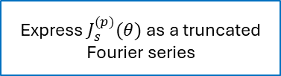
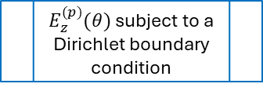

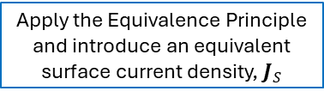


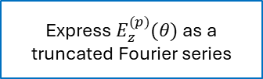
Circular Conductors Surrounded by a Homogeneous Lossless Medium
Surface Admittance Operator of the MTL
$$c_{p}$$
$$c_{q}$$
Multiconductor
Transmission Line
$$ε_{0},μ_{0}$$
$$c_{r}$$
$$J_{s}^{(p)}$$
$$a_{p}$$
$$a_{r}$$
$E_{z}^{(p)}(θ)$ subject to a Dirichlet boundary condition
$$J_{s}^{(q)}$$
Apply the Equivalence Principle and introduce an equivalent surface current density, $J_{S}$
$$a_{q}$$
$$J_{s}^{(r)}$$
Express $E_{z}^{(p)}(θ)$ as a truncated Fourier series
Express $J_{s}^{(p)}(θ)$ as a truncated Fourier series
In essence, the surface admittance concept is a simpler representation of the conductor which will allow us to simplify our original problem, just like Norton theorem helps simplify a circuit.
Using the surface admittance relationship, one can replace the conductor by an equivalent current source. Analogously, the surface admittance operator is the ratio of equivalent current and the electric fields on the boundary of the conductor.
Apply the boundary conditions to the tangential field components (Uniqueness Theorem)
$$𝕐_{s}$$

Slide 14





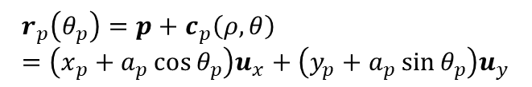
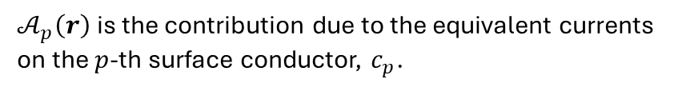
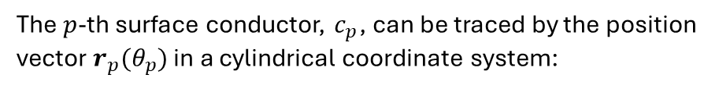


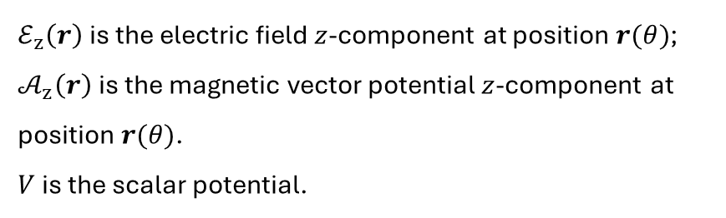




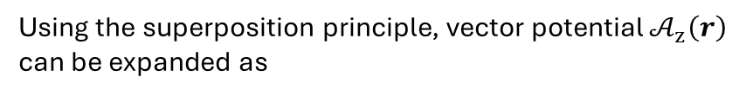
Circular Conductors Surrounded by a Homogeneous Lossless Medium
Electric Field Integral Equation (EFIE)
$$c_{p}$$
The effect of the equivalent current sources onto surrounding medium is modelled with the Electric Field Integral Equation:
$$a_{p}$$
$$J_{s}^{(p)}$$
$$θ_{p}$$
$$ℰ_{z}^{ }\left(r\right)=−jω𝒜_{z}\left(r\right)−\frac{∂V}{∂z}$$
$$r_{p}$$
$${(x}_{p}, y_{p})$$
$ℰ_{z}^{ }\left(r\right)$ is the electric field $z$-component at position $r(θ)$;
$𝒜_{z}^{ }\left(r\right)$is the magnetic vector potential $z$-component at position $r(θ)$.
$V$ is the scalar potential.
$$p$$
$$O$$
The $p$-th surface conductor, $c_{p}$, can be traced by the position vector $r_{p}(θ_{p})$ in a cylindrical coordinate system:
$$p=x_{p}u_{x}+y_{p}u_{y}$$
Using the superposition principle, vector potential $𝒜_{z}^{ }\left(r\right)$ can be expanded as
$$c_{p}\left(ρ,θ\right)=ρ_{p}u_{ρ}+θ_{p}u_{θ}=a_{p}(\cos{θ_{p}}u_{x}+\sin{θ_{p}}u_{y})$$
$$𝒜_{z}^{ }\left(r\right)=\sum_{p=1}^{m_{s}}{𝒜_{p}^{ }\left(r\right)}$$
$$r_{p}\left(θ_{p}\right)=p+c_{p}\left(ρ,θ\right)=\left(x_{p}+a_{p}\cos{θ_{p}}\right)u_{x}+\left(y_{p}+a_{p}\sin{θ_{p}}\right)u_{y}$$
$𝒜_{p}^{ }\left(r\right)$ is the contribution due to the equivalent currents on the $p$-th surface conductor, $c_{p}$.

Slide 15
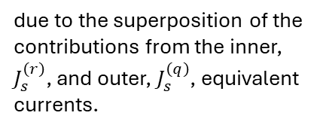

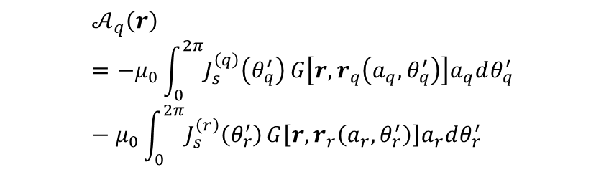


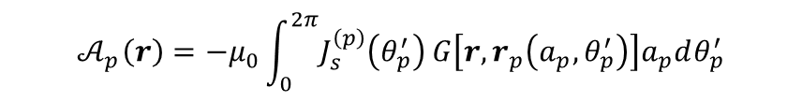


Circular Conductors Surrounded by a Homogeneous Lossless Medium
Electric Field Integral Equation (EFIE)
If conductor $p$ is solid, then
Consider the frequency independent (quasi-static) Green’s function of a two-dimensional homogeneous space:
$$𝒜_{p}^{ }\left(r\right)=−μ_{0}\int_{0}^{2π}{J_{s}^{\left(p\right)}\left(θ_{p}^{′}\right)}G\left[r,r_{p}\left(a_{p},θ_{p}^{′}\right)\right]a_{p}dθ_{p}^{′}$$
$$G\left[r,r^{′}\right]=\frac{1}{2π}\ln{|r−r^{′}|}$$
while, if conductor $q$ is hollow
$$𝒜_{q}^{ }\left(r\right)=−μ_{0}\int_{0}^{2π}{J_{s}^{\left(q\right)}\left(θ_{q}^{′}\right)}G\left[r,r_{q}\left(a_{q},θ_{q}^{′}\right)\right]a_{q}dθ_{q}^{′} −μ_{0}\int_{0}^{2π}{J_{s}^{\left(r\right)}\left(θ_{r}^{′}\right)}G\left[r,r_{r}\left(a_{r},θ_{r}^{′}\right)\right]a_{r}dθ_{r}^{′}$$
The quasi-static Green’s function is only accurate when [7]:
the cross-section of the cable is much smaller than a wave-length, so that the retardation effect may be neglected (the smallest wavelength of interest is 30 m at 10 MHz); and
the surrounding medium is lossless.
$$c_{q}$$
$$c_{r}$$
$$a_{r}$$
due to the superposition of the contributions from the inner, $J_{s}^{\left(r\right)}$, and outer, $J_{s}^{\left(q\right)}$, equivalent currents.
$$a_{q}$$
$$J_{s}^{(q)}$$
$$J_{s}^{(r)}$$

Slide 16
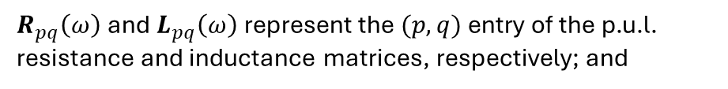
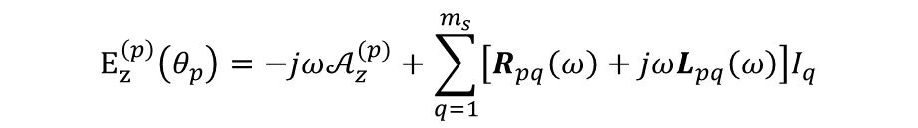
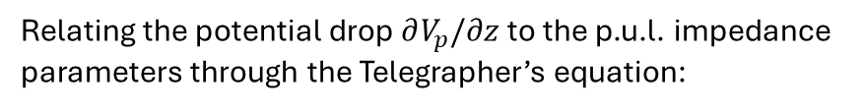

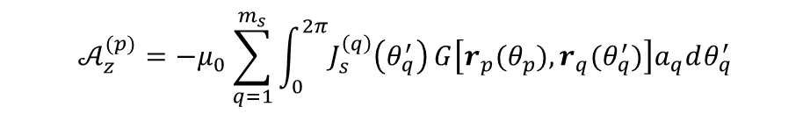

Circular Conductors Surrounded by a Homogeneous Lossless Medium
Electric Field Integral Equation (EFIE)
On the boundary of the $p$-th conductor, $c_{p}$, EFIE reads
Note that $a_{p}$, $E_{z}^{\left(p\right)}$, $𝒜_{z}^{(p)}$, $J_{s}^{\left(p\right)}$and $r_{p}$ on $p=1, 2, … , m_{1}$ concern the surface of the solid conductor; those on
$p=m_{1}+1, m_{1}+2, … , m_{1}+m_{2}=m_{c}$concern the outer surface of the hollow conductor, and those on
$p=m_{c}+1, m_{c}+2, … , m_{s}$ concern the inner surface of the hollow conductor.
$$E_{z}^{\left(p\right)}(θ_{p})=−jω𝒜_{z}^{(p)}−\frac{∂V_{p}}{∂z}$$
Relating the potential drop $∂V_{p}/∂z$ to the p.u.l. impedance parameters through the Telegrapher’s equation:
$$E_{z}^{\left(p\right)}\left(θ_{p}\right)=−jω𝒜_{z}^{(p)}+\sum_{q=1}^{m_{s}}{\left[R_{pq}\left(ω\right)+jωL_{pq}\left(ω\right)\right]I_{q}}$$
The main goal is to solve the p.u.l. impedance parameters, which will be done numerically by the MoM using the Fourier series expansions.
$R_{pq}\left(ω\right)$and $L_{pq}\left(ω\right)$represent the $(p, q)$entry of the p.u.l. resistance and inductance matrices, respectively; and
$$𝒜_{z}^{(p)}=−μ_{0}\sum_{q=1}^{m_{s}}{\int_{0}^{2π}{J_{s}^{\left(q\right)}\left(θ_{q}^{′}\right)}G\left[r_{p}(θ_{p}),r_{q}(θ_{q}^{′})\right]a_{q}dθ_{q}^{′}}$$

Slide 17
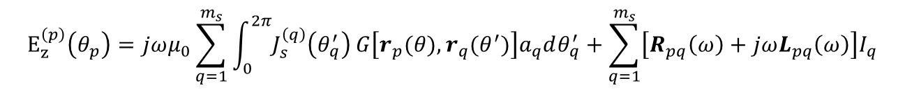
Circular Conductors Surrounded by a Homogeneous Lossless Medium
Analytic Evaluation of Discrete Green’s Function for solid conductors
Given an multiconductor cylindrical geometry, one can approximate the field and the current on the $p$-th surface for solid conductor by means of a truncated Fourier series:
$$E_{z}^{\left(p\right)}\left(θ_{p}\right)=jωμ_{0}\sum_{q=1}^{m_{s}}{\int_{0}^{2π}{J_{s}^{\left(q\right)}\left(θ_{q}^{′}\right)}G\left[r_{p}(θ),r_{q}(θ^{′})\right]a_{q}dθ_{q}^{′}}+\sum_{q=1}^{m_{s}}{\left[R_{pq}\left(ω\right)+jωL_{pq}\left(ω\right)\right]I_{q}}$$
$$\sum_{n=−N_{p}}^{N_{p}}{E_{n}^{(p)}e^{jnθ_{p}}}=jωμ_{0}\sum_{q=1}^{m_{s}}{\int_{0}^{2π}{\frac{1}{2πa_{q}}\sum_{n=−N_{p}}^{N_{p}}{J_{n}^{(q)}e^{jnθ_{q}^{′}}}}G\left[r_{p}(θ),r_{q}(θ^{′})\right]a_{q}dθ_{q}^{′}}+\sum_{q=1}^{m_{s}}{\left[R_{pq}\left(ω\right)+jωL_{pq}\left(ω\right)\right]I_{q}}$$
$$\sum_{n=−N_{p}}^{N_{p}}{E_{n}^{(p)}e^{jnθ_{p}}}=\frac{jωμ_{0}}{2π}\sum_{q=1}^{m_{s}}{\sum_{n=−N_{p}}^{N_{p}}{J_{n}^{(q)}}\int_{0}^{2π}{e^{jnθ_{q}^{′}}}G\left[r_{p}(a_{p},θ),r_{q}(a_{q},θ_{q}^{′})\right]dθ_{q}^{′}}+\sum_{q=1}^{m_{s}}{\left[R_{pq}\left(ω\right)+jωL_{pq}\left(ω\right)\right]I_{q}}$$

Slide 18
Reference
[1] U. R. Patel, B. Gustavsen and P. Triverio, "An Equivalent Surface Current Approach for the Computation of the Series Impedance of Power Cables with Inclusion of Skin and Proximity Effects," in IEEE Transactions on Power Delivery, vol. 28, no. 4, pp. 2474-2482, Oct. 2013, doi: 10.1109/TPWRD.2013.2267098.
[2] U. R. Patel, B. Gustavsen and P. Triverio, "Proximity-Aware Calculation of Cable Series Impedance for Systems of Solid and Hollow Conductors," in IEEE Transactions on Power Delivery, vol. 29, no. 5, pp. 2101-2109, Oct. 2014, doi: 10.1109/TPWRD.2014.2330994.
[3] D. De Zutter and L. Knockaert, "Skin effect modeling based on a differential surface admittance operator," in IEEE Transactions on Microwave Theory and Techniques, vol. 53, no. 8, pp. 2526-2538, Aug. 2005, doi: 10.1109/TMTT.2005.852766.
[4] R. F. Harrington, Time-harmonic electromagnetic fields. New York, NY: McGraw-Hill, c2001. xiii, 480 p.
[5] C. R. Paul, Analysis of Multiconductor Transmission Lines, 2nd ed. Hoboken, NJ, USA: Wiley, 2007.
[6] Tanaka, Y. et al. Development of a Computer Program for Calculating the Transmission-Line Constants of Cables Installed in a Tunnel Taking the Skin and Proximity Effects into Account. Proc. of International Conference on Power Systems Transients (IPST), Seoul, Republic of Korea. June 26-29, 2017
[7] U. R. Patel, A Surface Admittance Approach For Fast Calculation of the Series Impedance of Cables Including Skin, Proximity, and Ground Return Effects. 2014. University of Toronto, Graduate Department of The Edward S. Rogers Sr. Department of Electrical & Computer Engineering.

Slide 19





$$J_{s}$$
$$ε_{0},μ_{0}$$
$$ε_{c},{μ_{0}}_{ }, σ_{c }$$
$$ε_{0},μ_{0}$$
$$ε_{0},μ_{0}$$

Slide 20
















$$\vec{p}=x_{p}\hat{x}+y_{p}\hat{y}$$
$$a_{p}$$
$${\vec{c}}_{q}$$
$$θ_{p}$$
$${\vec{c}}_{p}\left(ρ,θ\right)=ρ_{p}\hat{ρ}+θ_{p}\hat{θ}=a_{p}(\cos{θ_{p}}\hat{x}+\sin{θ_{p}}\hat{y})$$
$${\vec{r}}_{p}$$
$${\vec{r}}_{q}$$
$${\vec{r}}_{p}\left(θ\right)=\vec{p}+{\vec{c}}_{p}(ρ,θ)$$
$$\vec{p}$$
$$\vec{q}$$
$${\vec{r}}_{p}(θ)=\left(x_{p}+a_{p}\cos{θ_{p}}\right)\hat{x}+\left(y_{p}+a_{p}\sin{θ_{p}}\right)\hat{y}$$
$$(0,0)$$
$${\vec{r}}_{q}(θ)=\left(x_{q}+a_{q}\cos{θ_{q}}\right)\hat{x}+\left(y_{q}+a_{q}\sin{θ_{q}}\right)\hat{y}$$
$${\vec{r}}_{p}$$
$${\vec{r}}_{q}$$
$$θ_{p}$$
$${\vec{c}}_{q}$$
$$\vec{p}=0$$
$$a_{p}$$
$$\vec{q}$$
$$(0,0)$$

Slide 21

















$$G\left(\vec{r},{\vec{r}}^{′}\right)=\frac{1}{2π}\ln\left|\vec{r}−{\vec{r}}^{′}\right|$$
$${\vec{r}}_{p}−{\vec{r}}_{q}$$
$$\vec{r}′′(θ)$$
$${\vec{c}}_{q}$$
$${\vec{r}}_{p}(θ)=\left(x_{p}+a_{p}\cos{θ_{p}}\right)\hat{x}+\left(y_{p}+a_{p}\sin{θ_{p}}\right)\hat{y}$$
$${\vec{r}}_{p}$$
$${\vec{r}}_{q}(θ)=\left(x_{q}+a_{q}\cos{θ_{q}}\right)\hat{x}+\left(y_{q}+a_{q}\sin{θ_{q}}\right)\hat{y}$$
$$\vec{q}$$
$$(0,0)$$
Patel’s auxiliary vector
$${\vec{r}}_{ }^{′′}\left(θ\right)={\vec{r}}_{p}\left(θ\right)−\vec{q}=\vec{p}−\vec{q}+{\vec{c}}_{p}\left(ρ,θ\right)$$
$${\vec{r}}_{p}−{\vec{r}}_{q}$$
$${\vec{r}}_{p}$$
$$\vec{r}′′(θ)$$
$${\vec{c}}_{q}$$
$${\vec{r}}_{ }^{′′}\left(θ\right)=\left(x_{p}−x_{q}+a_{p}\cos{θ_{p}}\right)\hat{x}+\left(y_{p}−y_{q}+a_{p}\sin{θ_{p}}\right)\hat{y}$$
$$\vec{p}=0$$
$$\vec{q}$$
$$(0,0)$$
$${\vec{r}}_{ }^{′′}\left(θ\right)=r^{′′}(\cos{θ^{′′}}\hat{x}+\sin{θ^{′′}}\hat{y})$$
Applying the Cosines’ Law:
$$|{\vec{r}}_{p}−{\vec{r}}_{q}|$$
$$r′′$$
$$a_{q}$$
$${\left|{\vec{r}}_{p}−{\vec{r}}_{q}^{ }\right|}^{ }={\left[{\left(r^{′′}\right)}^{2}+{(a_{q})}^{2} −2r^{′′}a_{q}\cos\left(γ\right)\right]}^{\frac{1}{2}}$$
$$γ$$
$$γ=θ^{′′}−θ_{q}^{′}$$

Slide 22


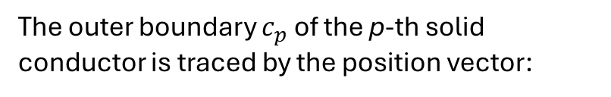


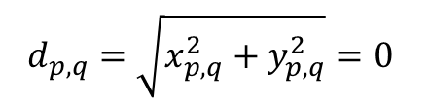
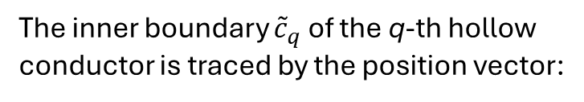


The outer boundary $c_{p}$ of the p-th solid conductor is traced by the position vector:
$$r_{p}(θ)=\left(x_{p}+a_{p}\cos{θ}\right)\hat{x}+\left(y_{p}+a_{p}\sin{θ}\right)\hat{y}$$
The inner boundary ${\tilde{c}}_{q}$ of the q-th hollow conductor is traced by the position vector:
$$ã_{q}$$
$$a_{p}$$
$$a_{q}$$
$$θ_{p}$$
$${\tilde{r}}_{q}(θ)=\left(x_{q}+ã_{q}\cos{θ}\right)\hat{x}+\left(y_{q}+ã_{q}\sin{θ}\right)\hat{y}$$
$$(x_{p},y_{p})$$
The distance between conductors
$$d_{p,q}=\sqrt{x_{p,q}^{2}+y_{p,q}^{2}}=0$$
$$x_{p,q}=x_{p} −x_{q}$$
$$y_{p,q}=y_{p} −y_{q}$$

Slide 23













$${\tilde{c}}_{q}^{′}$$
$$r_{p}−{\tilde{r}}_{q}$$
$$c_{p}$$
$$r_{p}−{\tilde{r}}_{q}$$
$${\tilde{r}}_{q}$$
$$r_{p}$$
$${\tilde{r}}_{q}$$
$$r_{p}$$
$$γ$$
$$O$$
$$O$$
$${\left|r_{p}−{\tilde{r}}_{q}^{′}\right|}^{ }={\left[{\left(ã_{q}^{′}\right)}^{2}+{(a_{p})}^{2} −2a_{p}ã_{q}^{′}\cos\left(γ\right)\right]}^{\frac{1}{2}}$$
$$γ={\tilde{θ}}_{q}^{′}−θ_{p}^{ }$$

Slide 24




$${\vec{J}}_{s}$$
$${\vec{r}}_{iq}$$
$${\vec{J}}_{s}$$
$${\vec{r}}_{p}$$
$$O$$
$${\vec{r}}_{oq}$$

Slide 25

$${\vec{J}}_{s}$$
$${\vec{r}}_{iq}$$
$${\vec{J}}_{s}$$
$${\vec{r}}_{p}$$
$$O$$
$${\vec{r}}_{oq}$$

